Slide 1





Extended Reality(XR) using Immersive Technology and Explainer Video Development
Presented by:
Ganesh Karuppaiah
XR Visual Content Designer

Slide 2

Agenda
What is immersive technology and why it is required?
Types of immersive technology/ experience
Virtual reality and it’s headsets
Augmented reality and it’s devices
Mixed reality and it’s headsets
Production workflow in developing a XR app
Tools involved in developing XR apps
Use cases of XR apps
Sample videos of XR apps
Explainer and Training video development

Slide 3

Extended Reality using Immersive Technology

Slide 4
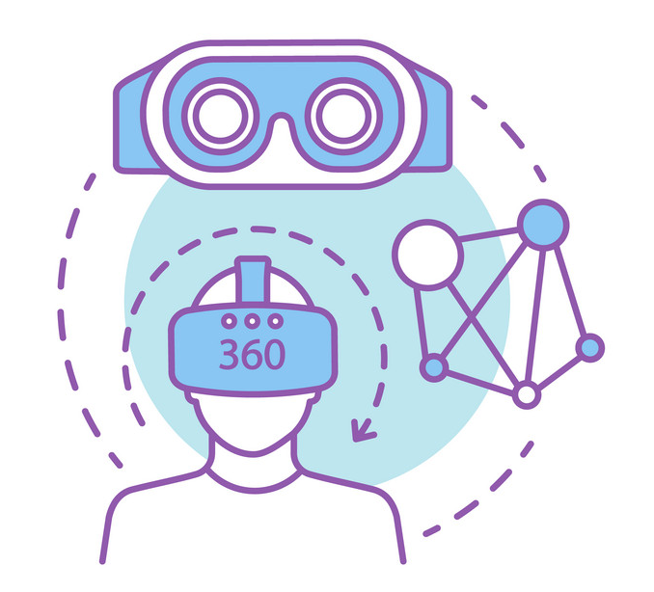
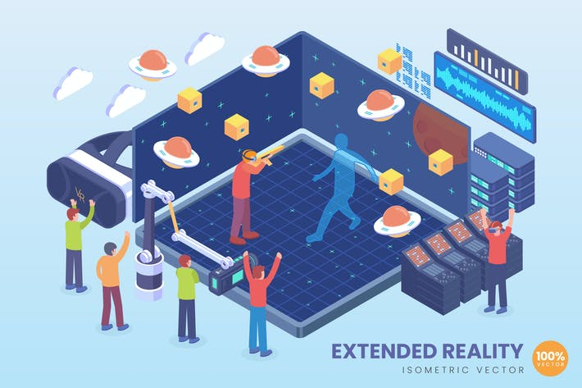
Immersive Technology
What is Immersive Technology?
The technology that extends reality or creates a new reality by leveraging the 360 space. In other words, creating new reality by completely shutting a user out from the real world and immersing them in a digital environment.
Why is Immersive Technology required?
Using Immersive technology, we can put/ engage a person into a virtual environment, enhancing one’s way of studying, working- and entertainment by making it more engaging or satisfying. The look and fell of the Immersive experiences will differ depending on where and how they are applied.

Slide 5
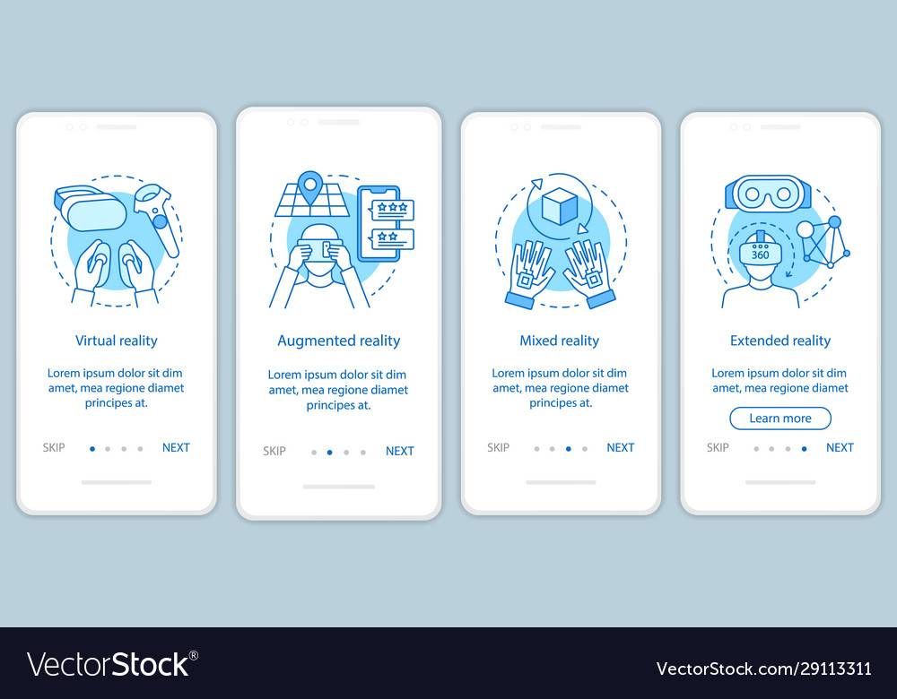
Types of Immersive Technology/ Experience
Virtual Reality
Augmented Reality
Mixed Reality
VR is a type of experience that essentially places the user in another world or dimension virtually. Generally, a CG environment or 360-degree videos are used to provide the immersive experience
AR is a type of experience that overlays digital/ CG content and information onto the physical world which give the feel to user as if they’re there with you, in your own space.
MR experience is a combination of digital/ CG created content placed into our real world. MR enables the virtual and real things interact with each other.

Slide 6
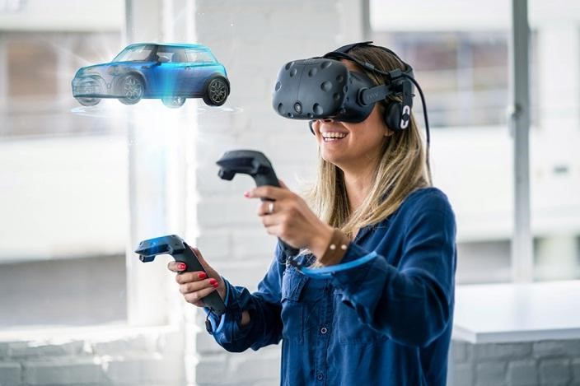
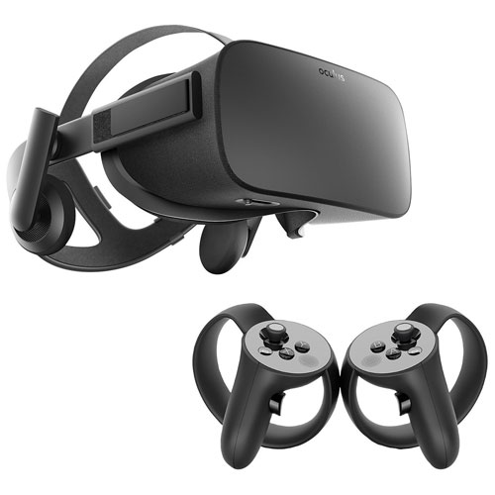
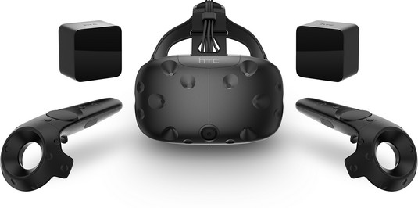
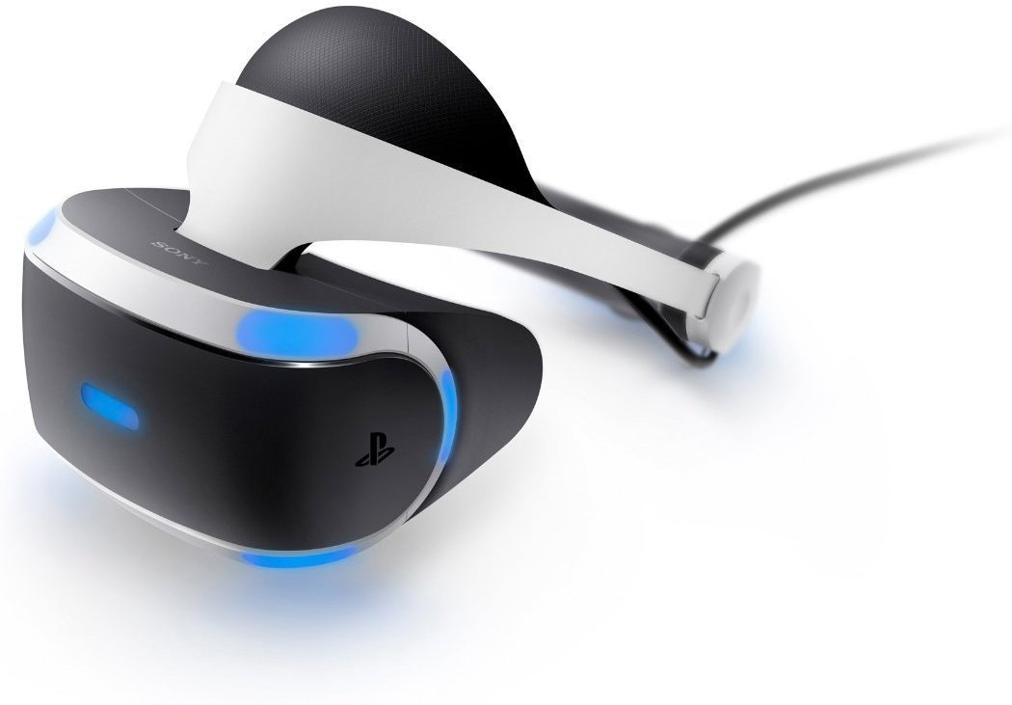
Virtual Reality Headsets

Slide 7
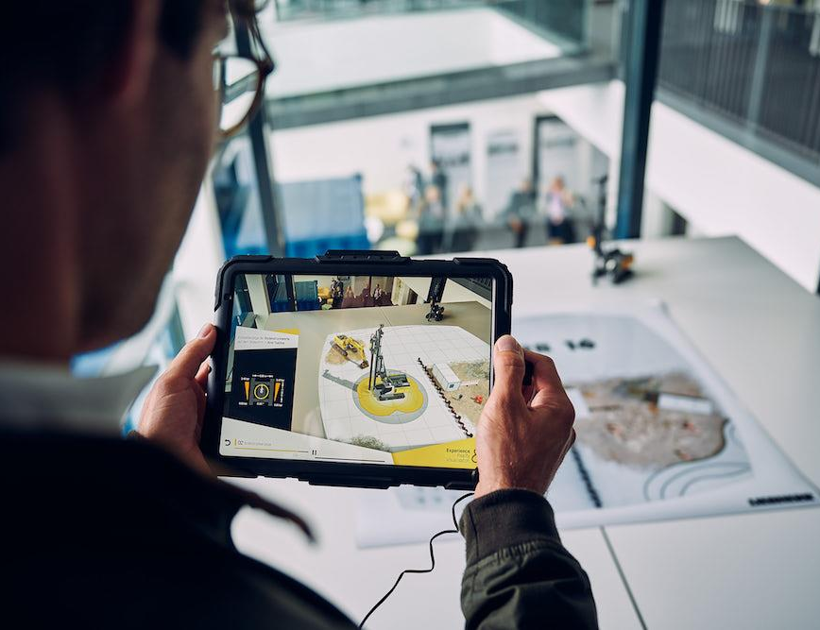
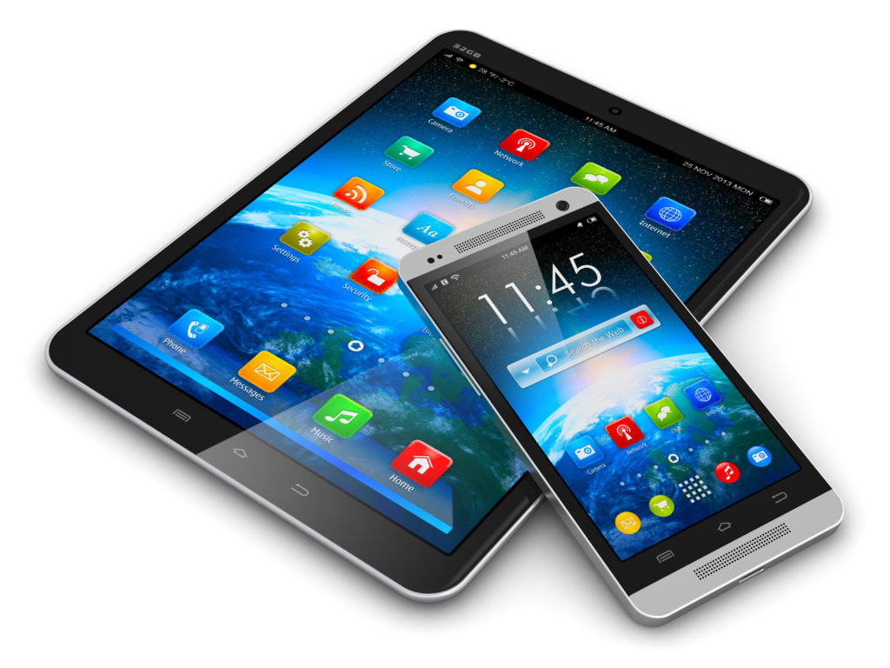
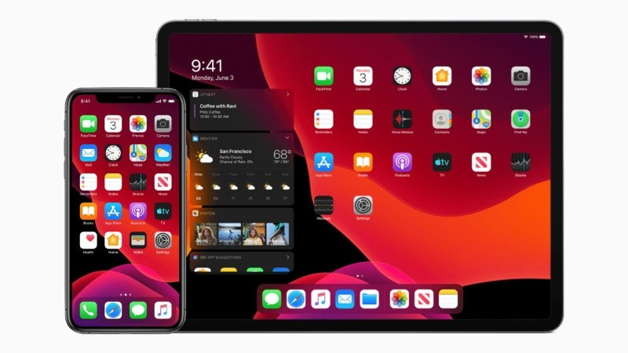
Augmented Reality Devices

Slide 8
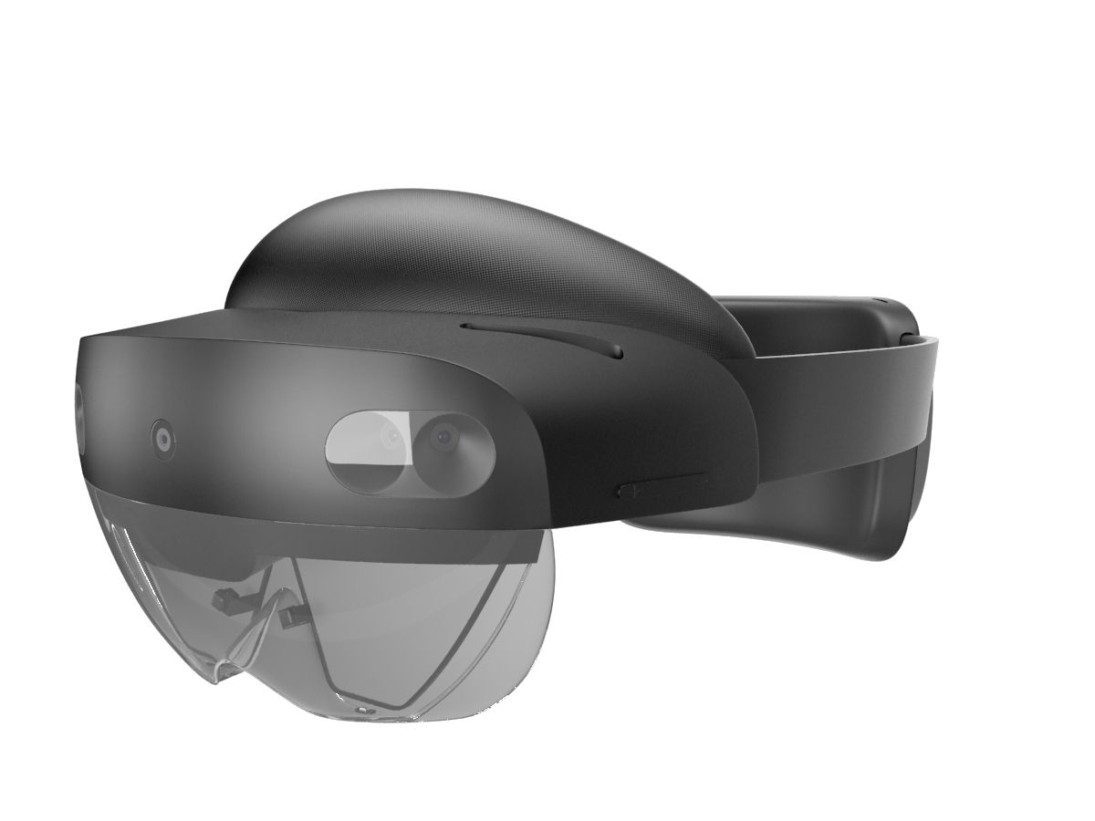

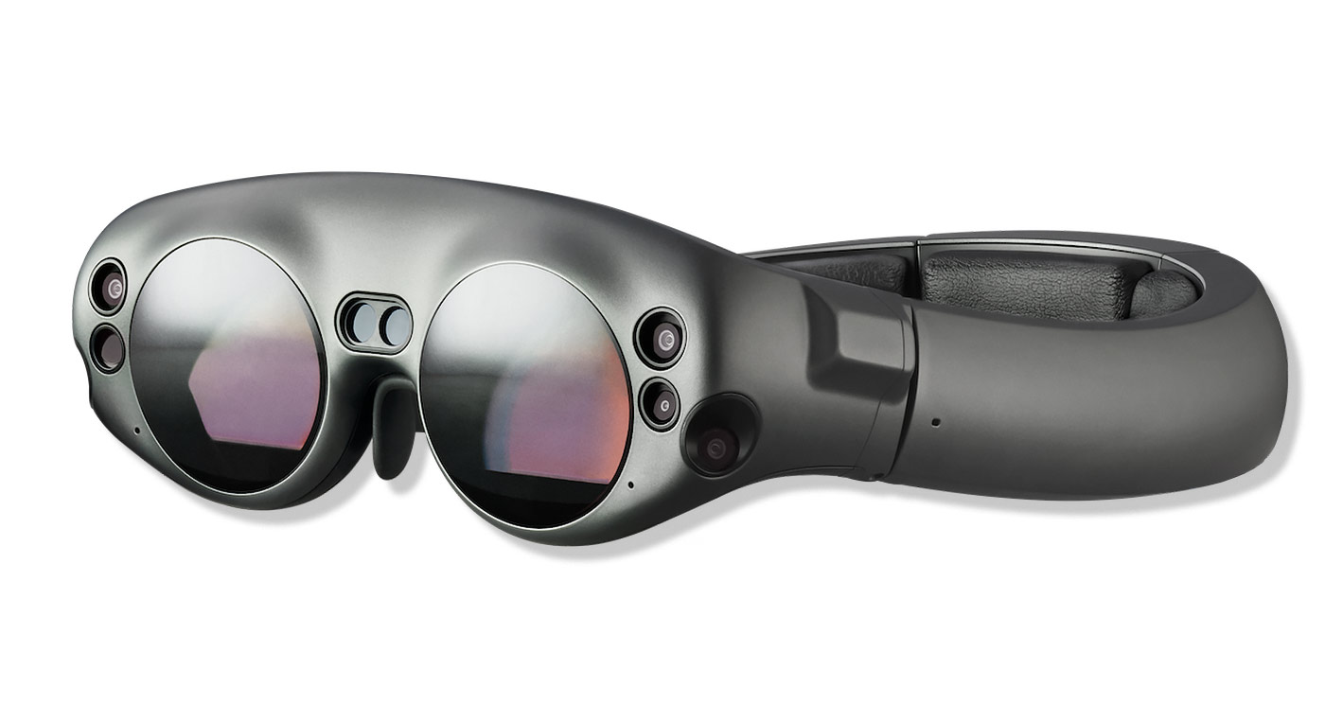
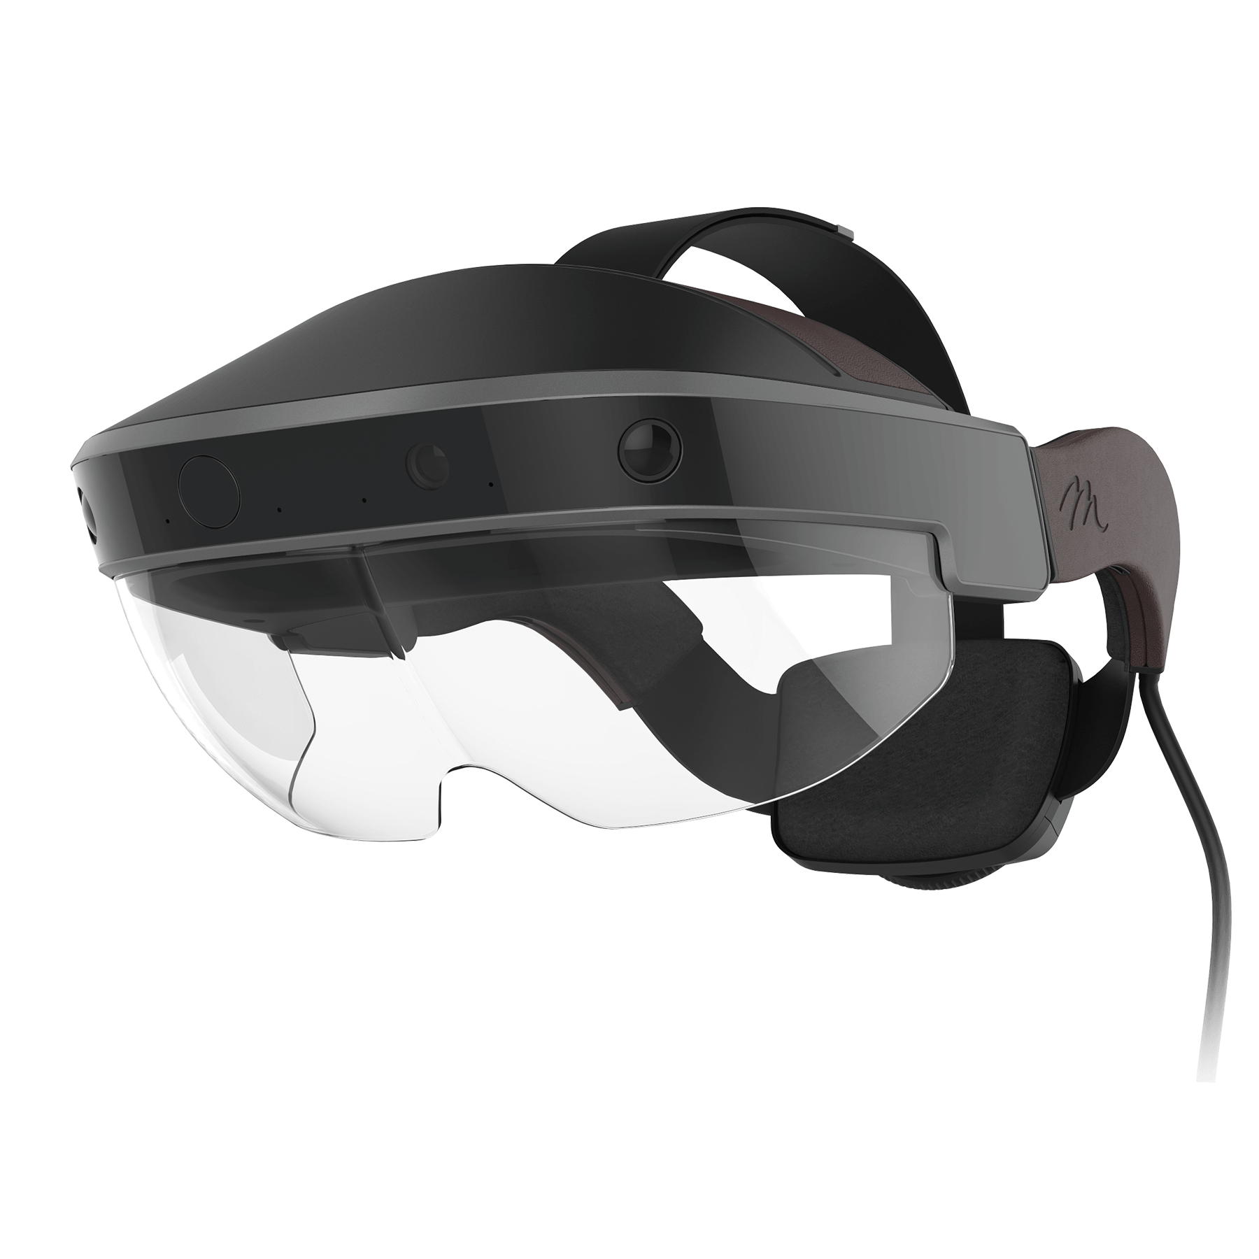
Mixed Reality Headsets

Slide 9





Production Workflow in Developing a XR app
Requirement Analysis:
Gathering customer’s app requirement and analyzing all feasible ways to make the production workflow viable.
Storyboarding/ Instruction Designing:
A graphic representation of how the app will be structured, with every user interactions. It consists of rough illustrations of every visuals and user interaction as notes.
App Development:
CG artist, Game developers and UI designers work together on developing the app having the provided storyboard as an instruction/ reference.
Customer Feedback Implementation and Content Delivery:
Once the app reached a stage an Alpha version will be released for customer feedbacks. After this, app team will make necessary implementation process and then final version of the app will be released on customer’s sign-off.

Slide 10






Tools Involved in Developing XR apps

Slide 11
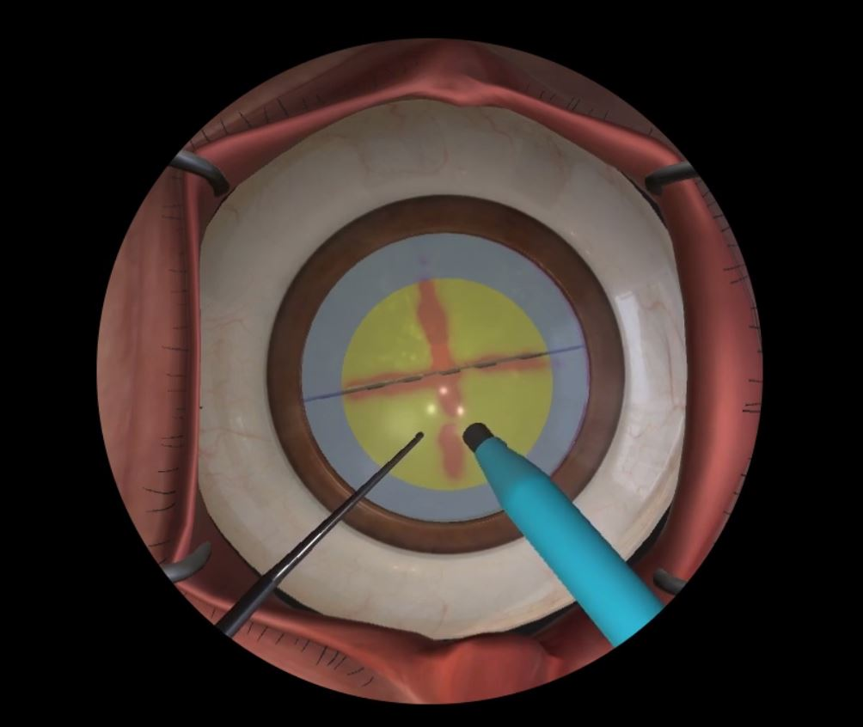
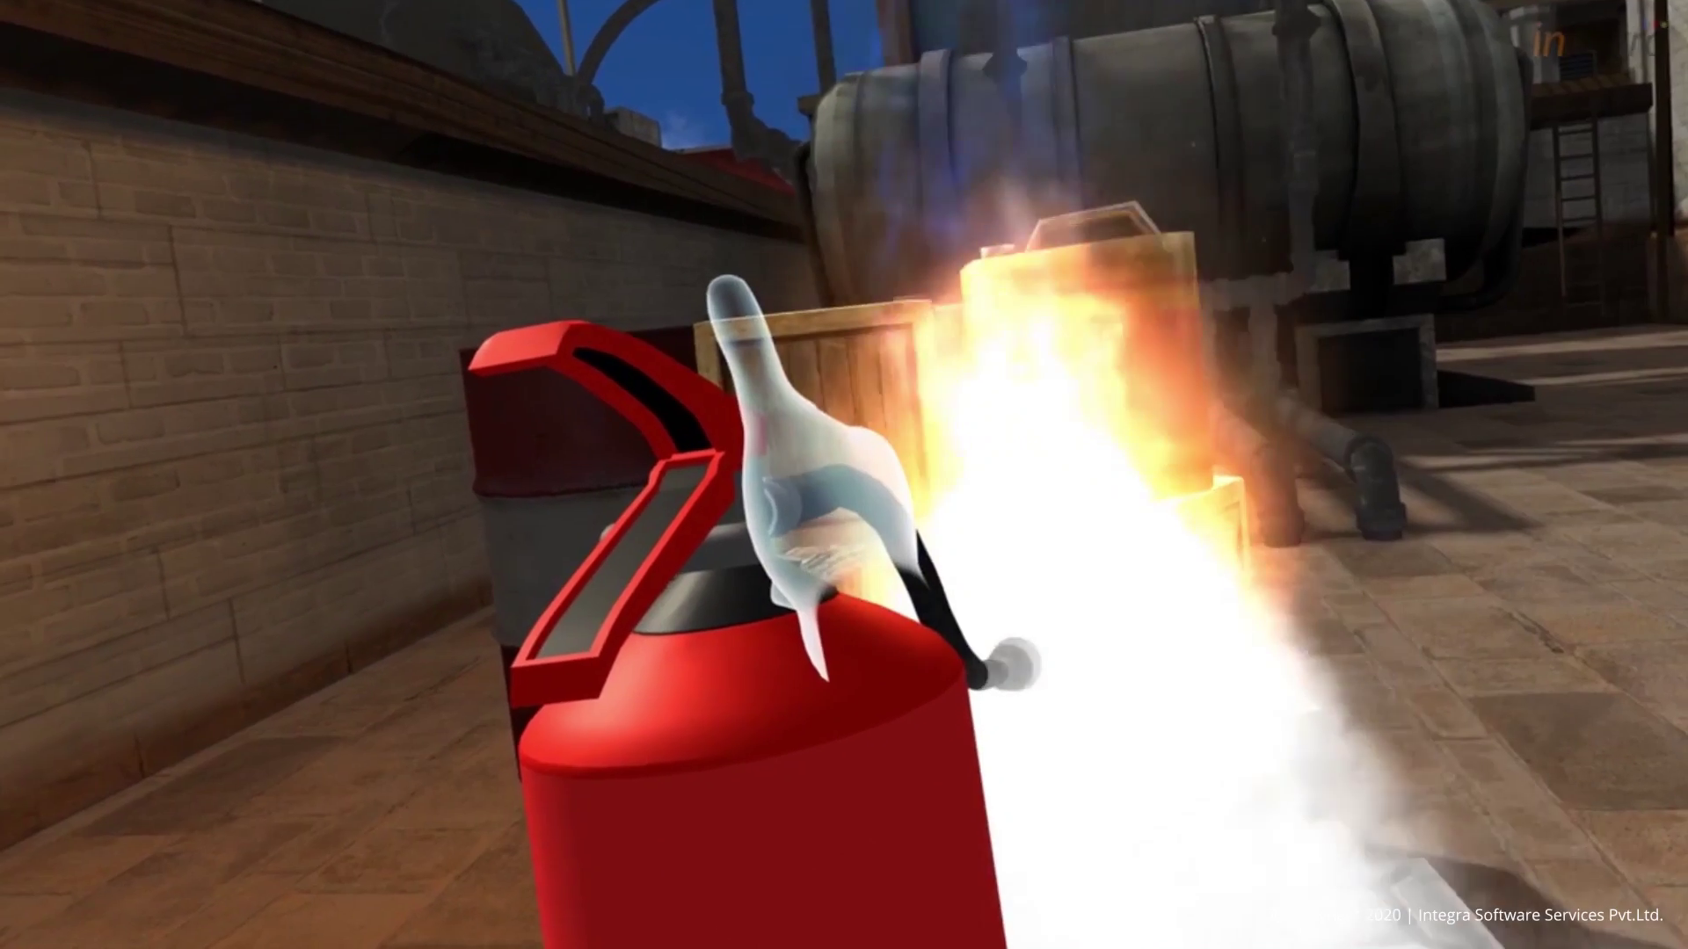
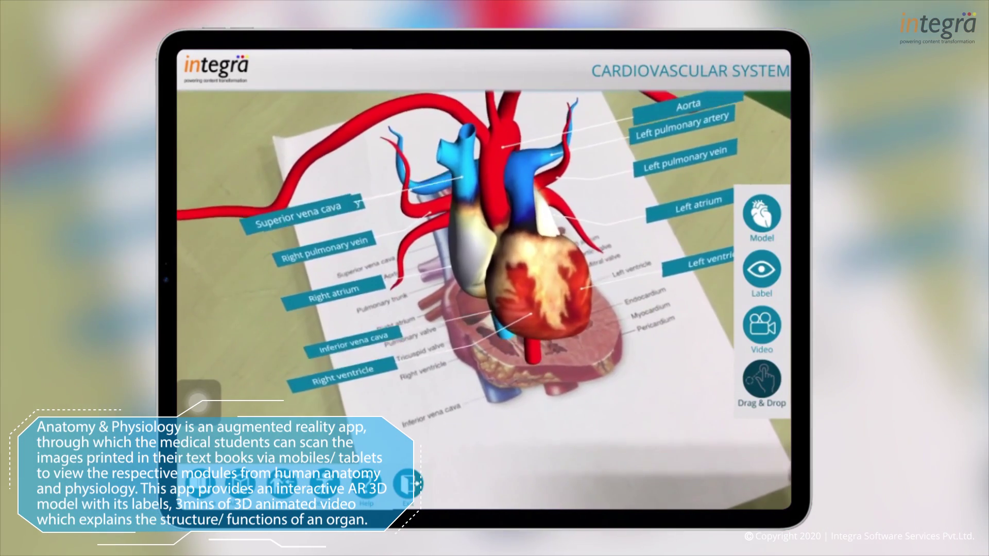
Use Cases of XR Apps
Eye Cataract Surgery VR Simulation:
This VR application enables the trainee surgeon to get hands on experience on the cataract surgery. This app trains the users in various scenarios such as changing the type of the cataract and with different surgical equipment’s. The user will be interacting with the virtual eye using Touch X haptic devices.
Fire Safety – VR Training App :
This VR application enables the user to know about different types of fire and its respective extinguishers. User will be placed in a virtual environments where he/ she need to extinguish the fire so that they will be get trained how to act properly during a fire emergency.
Human Anatomy AR:
This AR mobile app acts as an additional training material for the medical students who are learning a specific books. Students can scan the anatomical images from pages via AR app which brings them virtual 3D models of the respective human organs in AR. This app also comprises with two minutes 3D animation video which explains the some of the major topic relative to the organ and evaluate the students with 3D drag & drop assessment.

Slide 12


Sample Videos on XR Apps

Slide 13

Explainer and Training Video Development

Slide 14


Different Styles of Video Development
Motion Graphics
White Board
Pre-rendered Templates
1
2
3

Slide 15

Production Workflow in Video Development
Requirement Analysis:
Gathering product related details from customer and analyzing all feasible ways to make the production workflow viable.
Storyboarding/ Instruction Designing:
A graphic representation of how the video will unfold, shot by shot. It consists of rough illustrations of every shot with its action notes and audio script.
Video Development:
Graphic artist and Video editors work together on developing the video having the provided storyboard as an instruction/ reference.
Customer Feedback Implementation and Content Delivery:
Once the first cut of video has been developed, customer’s feedbacks and implementing session will kick-off. After the implementations has been done, video will be shared with the customer for approval/ sign-off.

Slide 16


Tools Involved in Video Development
Motion Graphics
White Board
Pre-rendered Templates

Slide 17
Video Development - Style Comparison
Unlimited creativity
Create and customize the visuals
Flexible to achieve the concept
Motion Graphics
Pre-rendered Templates
Visual contents will be limited within the provided presets
and pre-rendered animations
In-built presets and pre-rendered animations will
minimize the TAT and cost of the video development
Simple user interface which doesn’t require
any video developing professional
Limit’s creativity and visuals
within the white board concept
Flexible to achieve the concept
White Board

Slide 18
Sample Explainer Videos
Motion Graphics:
https://www.youtube.com/watch?v=O3rQ3KYb4ew
https://www.youtube.com/watch?v=-bknuFCQn4Y
White Board Animation:
https://www.youtube.com/watch?v=LlDXZDQUOfE
Render Forest:
https://www.youtube.com/watch?v=1vXdTbJcYwo

Slide 19


Slide 20
Extended Reality using Immersive Technology

